Slide 1


Machine Learning with PyCaret + MLflow
Apr 27, 2021

Slide 2





About me
Data Scientist with 10+ years of experience in solving business problems using data.
Background in Finance, Economics, Analytics, and Data Science.
Worked in Healthcare, Education, Consulting, and Fintech.
Member of CPA, CMA, Canada and ACMA, UK, CGMA
Lived and worked in Asia, Middle East, East Africa, North America. Currently based in Toronto, Canada
https://www.linkedin.com/in/profile-moez/
https://moez-62905.medium.com/
https://twitter.com/moezpycaretorg1
moez@pycaret.org

Slide 3
Important Links
Official : https://www.pycaret.org
Docs: https://pycaret.readthedocs.io/en/latest/
PyCaret GitHub : https://www.github.com/pycaret/pycaret
LinkedIn : https://www.linkedin.com/company/pycaret
YouTube : https://www.youtube.com/channel/UCxA1YTYJ9BEeo50lxyI_B3g
Medium : https://moez-62905.medium.com/
Today’s Presentation and Demo : https://www.github.com/pycaret/pycaret-demo-mlflow
Follow hashtag #pycaret on LinkedIn and Twitter

Slide 4

Join our community!
https://join.slack.com/t/pycaret/shared_invite/zt-p7aaexnl-EqdTfZ9U~mF0CwNcltffHg

Slide 5
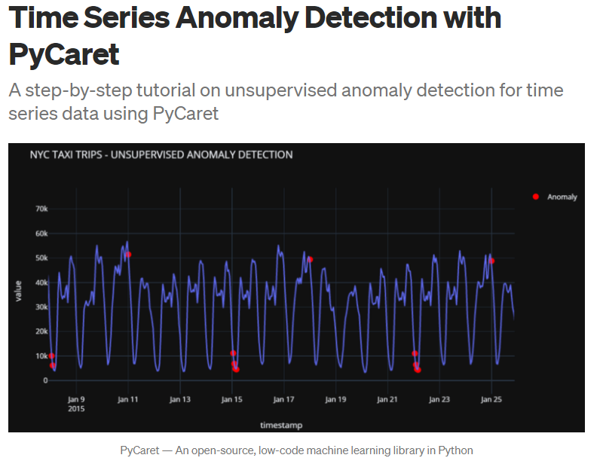
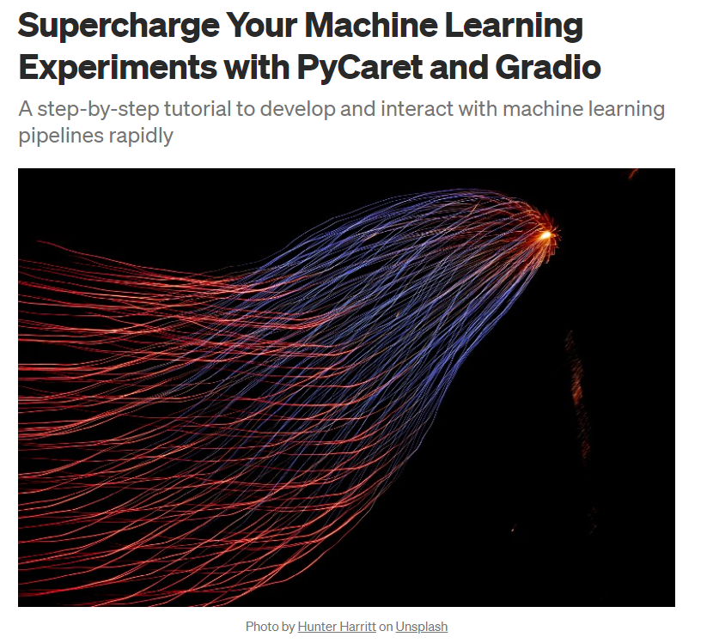
Resources

Slide 6
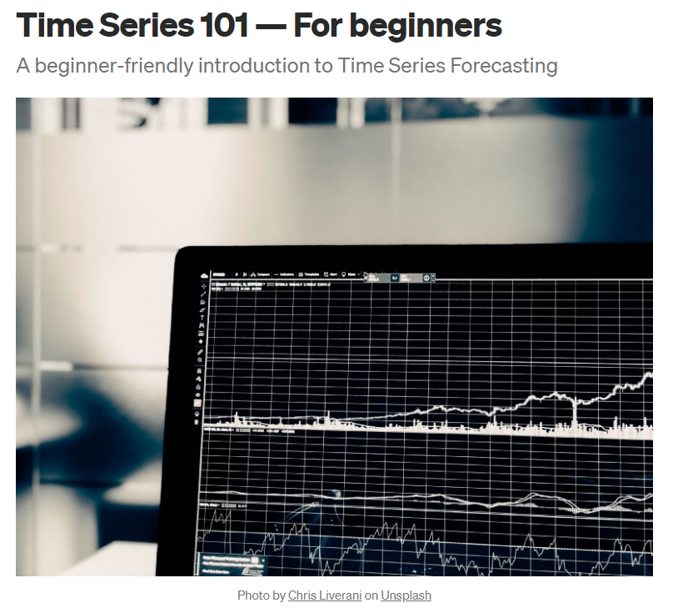
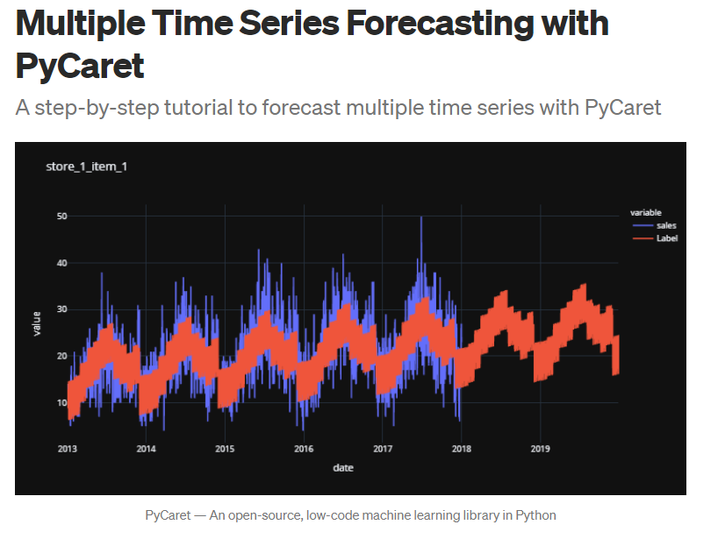
Resources (cont.)

Slide 7
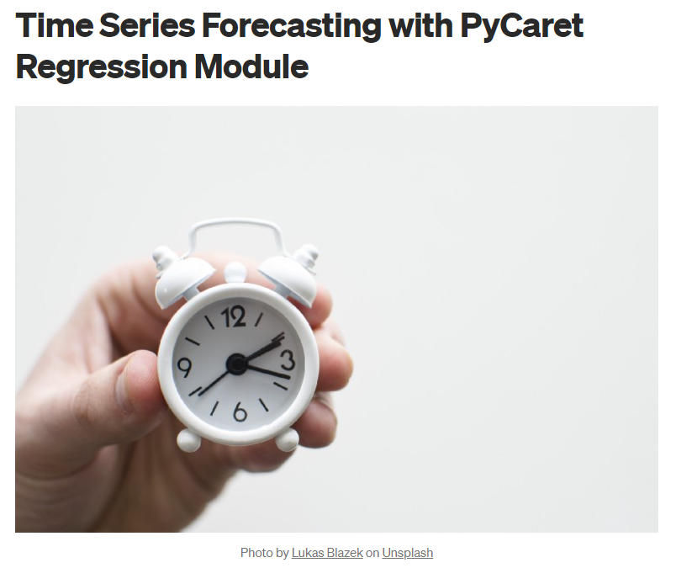

Resources (cont.)

Slide 8
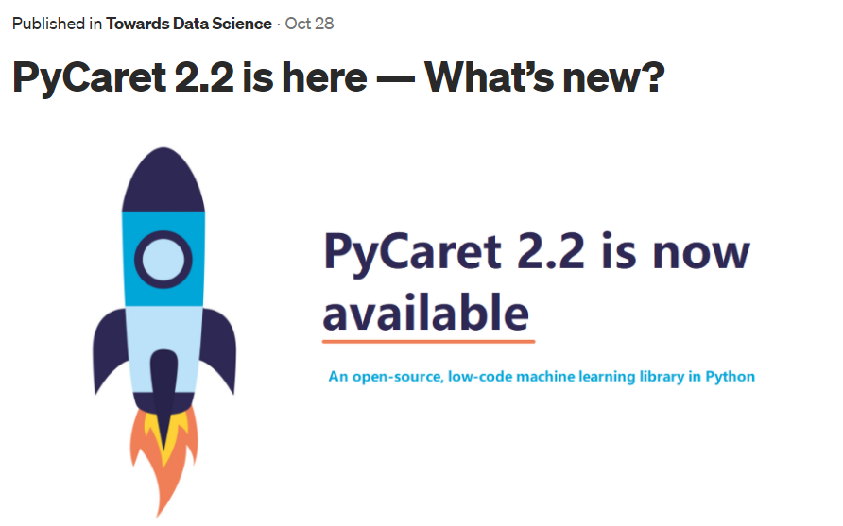
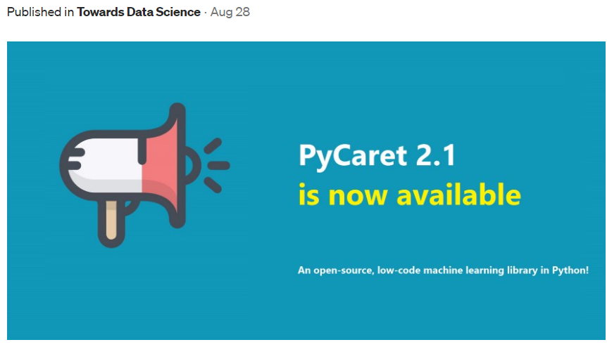
Resources (cont.)

Slide 9
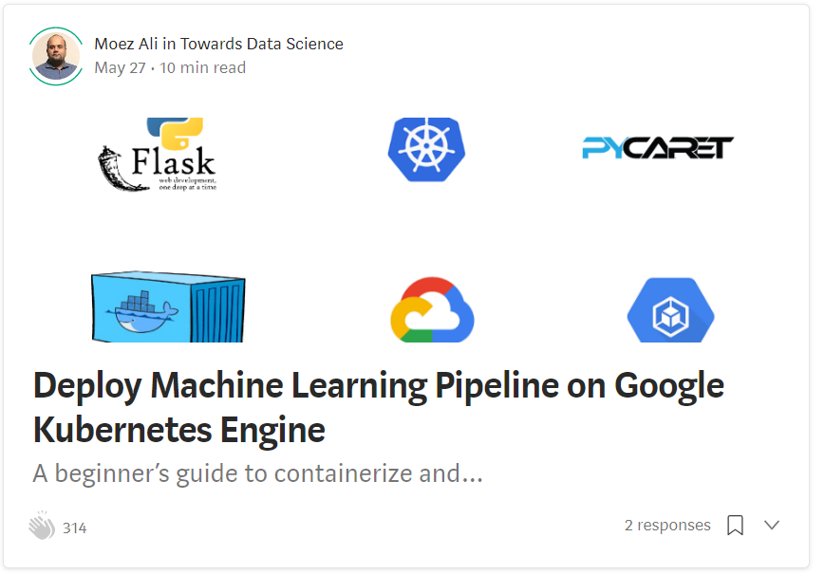
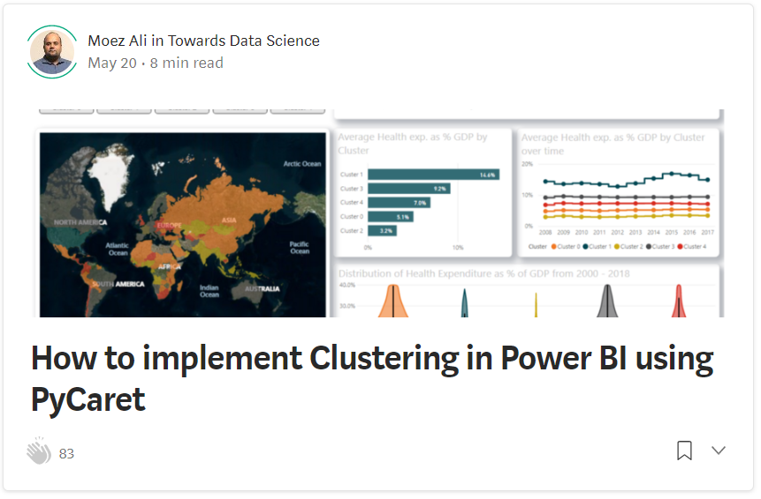
Resources (cont.)

Slide 10
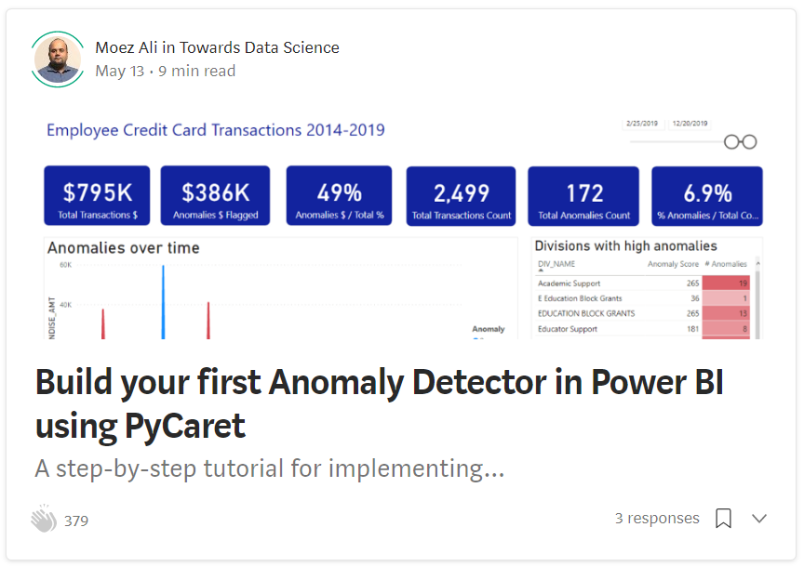
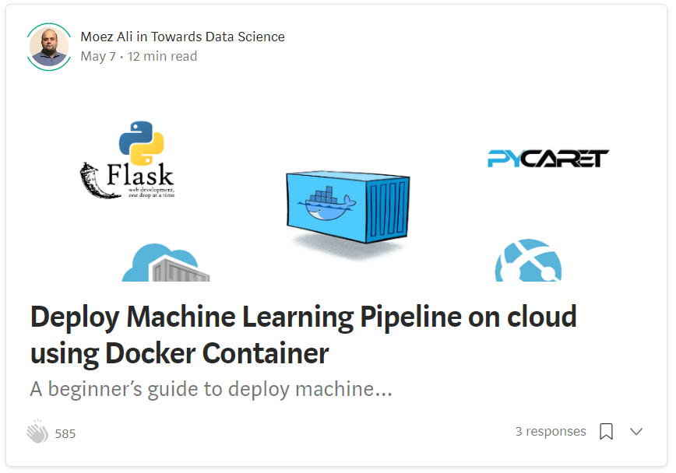
Resources (cont.)

Slide 11
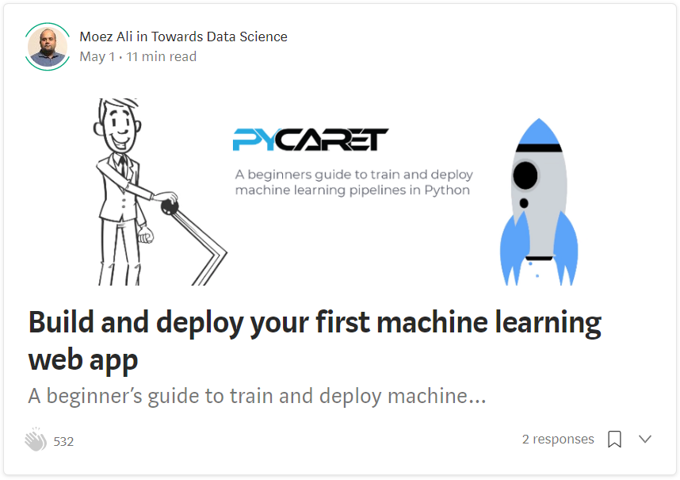
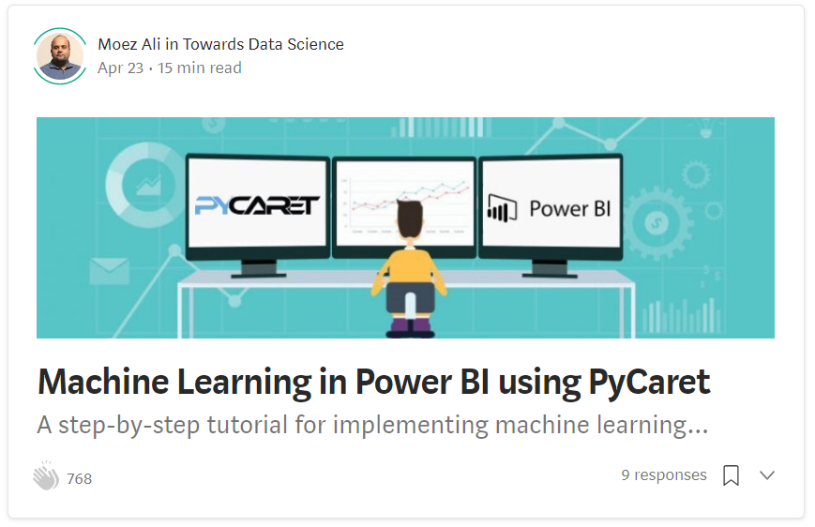
Resources (cont.)

Slide 12
Let’s get started

Slide 13
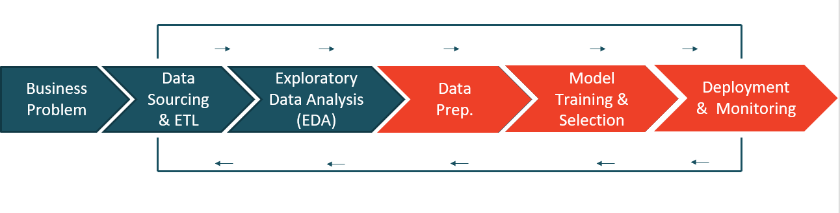
Machine Learning Life Cycle

Slide 14



What is PyCaret?
PyCaret is an open source, low-code machine learning library and end-to-end model management tool created to help you automate your machine learning workflows in Python. It is commonly used for rapid prototyping and deployment of ML pipelines.
EASY TO USE
PRODUCTIVITY TOOL
BUSINESS READY

Slide 15
Impact of PyCaret
Cumulative lines of code
Machine Learning Workflow

Slide 16
Machine Learning use-case supported:
Classification
Regression
Time Series
SUPERVISED
Clustering
Anomaly Detection
Association Rule Mining
Natural Language Processing
UNSUPERVISED

Slide 17


Train Model
Tune Model
Analyze Model
Deploy Model
Prepare Data, Train Model, Tune Hyperparameters, Evaluate Performance
Record and query experiments: code, data, config, and results

Slide 18
Thank you
Questions?

